Slide 1
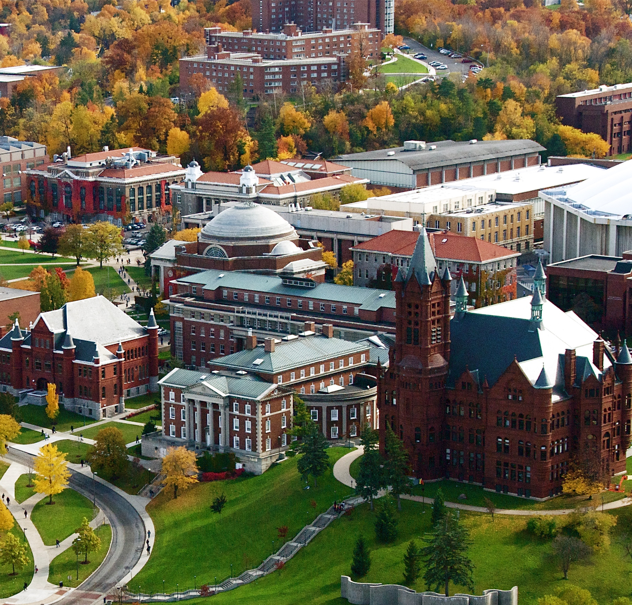
Advanced Topic: gganimate
Graham Latsa

Slide 2
What is “gganimate”
R Package
ggplot extension
Converts ggplots into an animated GIF, based upon a determined “Transition”

Slide 3
Why is gganimate important to me
Hans Rosling, TED Talk & Website (highly recommend)
Embraces the Digital Medium
Easy to Use
Cool Little Bar Trick

Slide 4
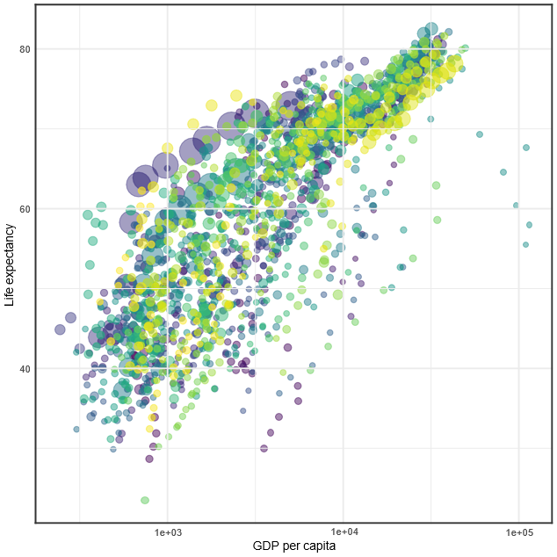
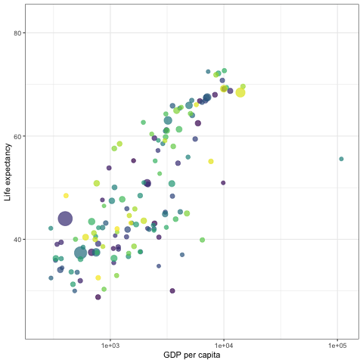
Getting Started
library(gganimate)
library(gifski)
library(png)
library(av)

Slide 5
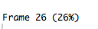
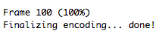
How to Make the Animation Work
Get your ggplot set up
Add your desired “transition” function to your ggplot
Animate your ggplot with the animate() Function
Save your file with the anim_save() function

Slide 6
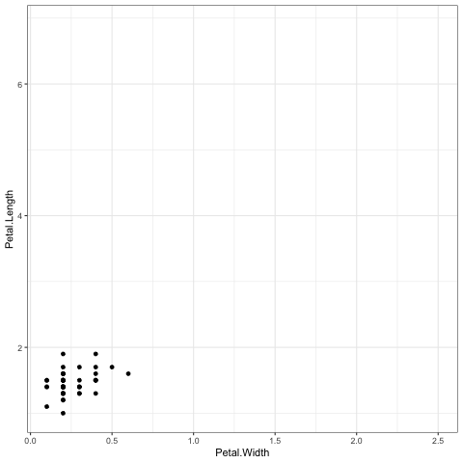
Example Code
p <- ggplot(iris, aes(x = Petal.Width, y = Petal.Length)) + geom_point()
anim <- p + transition_states(Species, 2*,1**)
animate(anim, renderer = gifski_renderer(loop = T))
anim_save("title.GIF", animation = last_animation(), 'Directory')
Note
Play around with library(gapminder)
* = Transition Length
** = State Length

Slide 7
What Gapminder Data Looks like
Classes ‘tbl_df’, ‘tbl’ and 'data.frame': 1704 obs. of 6 variables:
$ country : Factor w/ 142 levels "Afghanistan",..: 1 1 1 1 1 1 1 1 1 1 ...
$ continent: Factor w/ 5 levels "Africa","Americas",..: 3 3 3 3 3 3 3 3 3 3 ...
$ year : int 1952 1957 1962 1967 1972 1977 1982 1987 1992 1997 ...
$ lifeExp : num 28.8 30.3 32 34 36.1 ...
$ pop : int 8425333 9240934 10267083 11537966 13079460 148803...
$ gdpPercap: num 779 821 853 836 740 ...

Slide 8
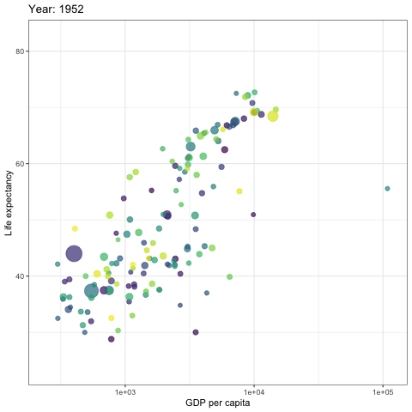
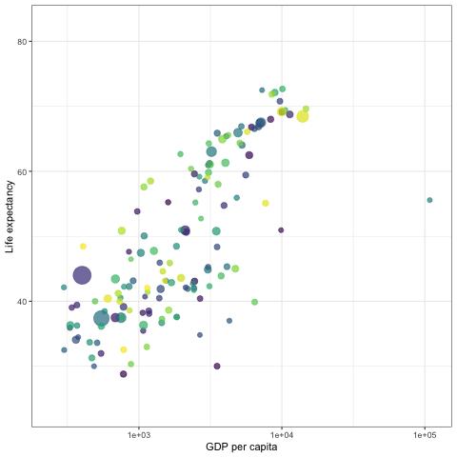

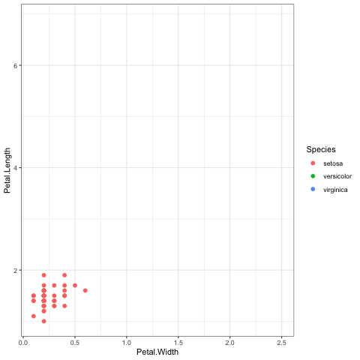
Additional Ways to Manipulate Animation
And Many More
……..
2.Making Transition Sporadic
4. Making Transition Fade
3. Making Transition Slow
1. Adding a Moving Title

Slide 9
How I Made those transitions
I added “labs(title = "Year: {frame_time}")”
I added “ease_aes('cubic-in-out’)”
I removed ”Transition_time” to “Transition_states(year, 4, 1)” and in the animation() function I added “duration = 20”
I added “enter_fade() + exit_shrink()”
Note You can explort as a video:
vid <- animate(anim, renderer = av_renderer('Title.mp4'), width = 1280, height = 720, res = 104, fps = 25)

Slide 10
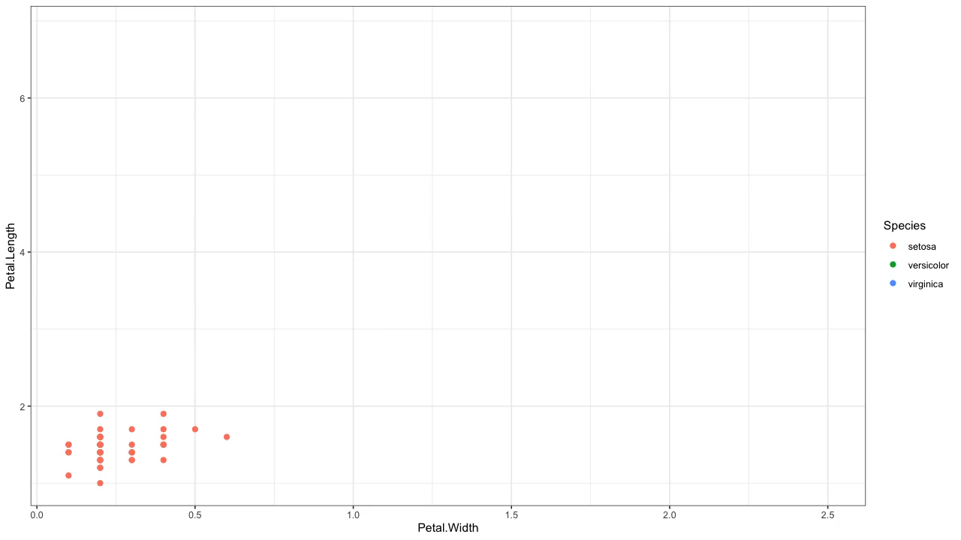
The Video

Slide 11
“Transition” Functions
^{transition_components}
^{transition_events}
^{transition_filter}
^{transition_layers}
^{transition_manual}
^{transition_reveal}
^{transition_states}
^{transition_time}
Notes:
Components Kind of like manual
Events Logical
Filter puts things on and off

Slide 12
Code for Animation
Notes:
Components Kind of like manual
Events Logical
Filter puts things on and off

Slide 13

Questions

